Slide 1
DSECFZC415 – Data Mining
Session 1: Introduction to Data Mining
Mayank Rasu
mayank.rasu@wilp.bits-pilani.ac.in

Slide 2
Lecture Outline
Data Mining definitions
Data Mining activities
DM process
DM challenges
Reference: Chapter 1 from Tan P. N., Steinbach M & Kumar V. “Introduction to Data Mining” Pearson Education, 2006

Slide 3
What Is Data Mining?
Data mining (knowledge discovery from data)
Extraction of interesting (non-trivial, implicit, previously unknown and potentially useful) patterns or insight or trend from huge amount of data. The patterns can be observed directly by humans.
Data mining: a misnomer? As we try to generate knowledge from data. In actual mining we produce a lot of raw materials and produce metals. However, here the raw material (Data) is already available hence it should have ideally been called Knowledge mining.
Alternative names
Exploratory Data Analysis, Knowledge discovery in databases (KDD), knowledge extraction, data/pattern analysis, data archeology, data dredging, information harvesting, business intelligence, etc.
Watch out: Is everything “data mining”?
Simple search and query processing
(Deductive) expert systems

Slide 4
What is (not) Data Mining?
What is not Data Mining?
Look up phone number in phone directory
Query a Web search engine for information about “Amazon”
What is Data Mining?
Certain names are more prevalent in certain US locations (O’Brien, O’Rurke, O’Reilly… in Boston area)
Group together similar documents returned by search engine according to their context (e.g. Amazon rainforest, Amazon.com,)

Slide 5
Why Data Mining?
The Explosive Growth of Data: from terabytes to petabytes
Applications have increased significantly
Diverse forms of data, earlier it would mostly be structured data
Data collection and data availability
Automated data collection tools, database systems, Web, computerized society
Major sources of abundant data
Business: Web, e-commerce, transactions, stocks, …
Science: Remote sensing, bioinformatics, scientific simulation, …
Society and everyone: news, digital cameras, YouTube
Challenge
Making sense of data
We are drowning in data, but starving for knowledge!
“Necessity is the mother of invention”—Data mining—Automated analysis of massive data sets

Slide 6
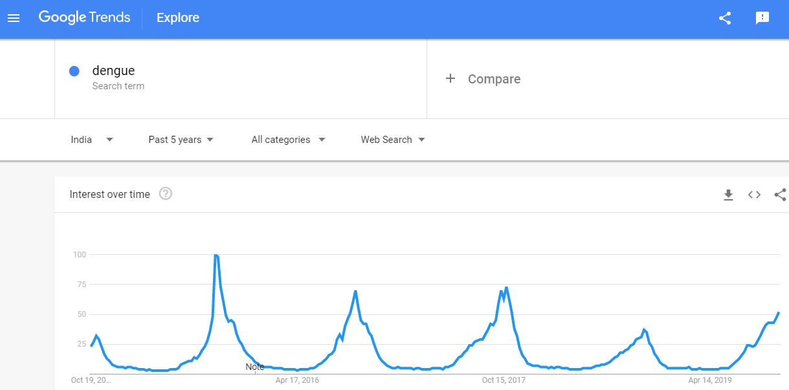
Why Data Mining
A great example of data mining is google trends
Huge collection of queries which can be analyzed for patterns which cannot be obtained by reading individual data items alone.
Google's Flu Trends - close relationship between the number of people who search for flu-related information and the number of people who actually have flu symptoms. Flu Trends can estimate flu activity up to two weeks faster than traditional systems
Dengue search result in India over past 5 years
Do you see something interesting?

Slide 7
Evolution of Database Technology
1960s:
Data collection, database creation, IMS and network DBMS, primarily hierarchical databases
1970s:
Relational data model, relational DBMS implementation
1980s:
RDBMS, advanced data models (extended-relational, OO, deductive, etc.)
Application-oriented DBMS (spatial, scientific, engineering, etc.)
Till here it was mostly numbers and texts, from 90s data growth became non-linear and forms such as multimedia came into being. Social media, applications, devices continuously feed data
Variety, Velocity, Volume have all increased.
1990s:
Data mining, data warehousing, multimedia databases, and Web databases
2000s
Stream data management and mining
Data mining and its applications
Web technology (XML, data integration) and global information systems
Notes:
Two slides should be added after this one
1. Evolution of machine learning
2. Evolution of statistics methods

Slide 8
Origins of Data Mining
Draws ideas from machine learning/AI, pattern recognition, statistics, and database systems
Traditional Techniques may be unsuitable due to
Enormity of data
High dimensionality of data
Heterogeneous, distributed nature of data
Statistics/ AI
Machine Learning/
Pattern Recognition
Data Mining
Database systems

Slide 9
Data Mining in Business Intelligence
Increasing potential
to support
business decisions
End User
Decision Making
Data Presentation
Business
Analyst
Visualization Techniques
Data Mining
Data
Analyst
Information Discovery
Data Exploration
Statistical Summary, Querying, and Reporting
Data Preprocessing/Integration, Data Warehouses
Data Sources
DBA
Paper, Files, Web documents, Scientific experiments, Database Systems

Slide 10
Data Mining/KDD Process
Pattern
Information
Knowledge
Input Data
Data Pre-Processing
Data Mining
Post-Processing
Data integration
Normalization
Feature selection
Dimension reduction
Pattern discovery
Association & correlation
Classification
Clustering
Outlier analysis
… … … …
Pattern evaluation
Pattern selection
Pattern interpretation
Pattern visualization

Slide 11
Multi-Dimensional View of Data Mining
Data to be mined
Database data (extended-relational, object-oriented, heterogeneous, legacy), data warehouse, transactional data, stream, spatiotemporal, time-series, sequence, text and web, multi-media, graphs & social and information networks
Knowledge to be mined (or: Data mining functions)
Characterization, discrimination, association, classification, clustering, trend/deviation, outlier analysis, etc.
Descriptive vs. predictive data mining
Multiple/integrated functions and mining at multiple levels
Techniques utilized
Data-intensive, data warehouse (OLAP), machine learning, statistics, pattern recognition, visualization, high-performance, etc.
Applications adapted
Retail, telecommunication, banking, fraud analysis, bio-data mining, stock market analysis, text mining, Web mining, etc.

Slide 12
Data Mining on Diverse kinds of Data
Besides relational database data (from operational or analytical systems), there are many other kinds of data that have diverse forms and structures and different semantic meanings.
Examples of data can be :
time-related or sequence data (e.g., historical records, stock exchange data, and time-series and biological sequence data),
data streams (e.g., video surveillance and sensor data, which are continuously transmitted),
spatial data (e.g., maps),
engineering design data (e.g., the design of buildings, system components, or integrated circuits),
hypertext and multimedia data (including text, image, video, and audio data),
graph and networked data (e.g., social and information networks), and
the Web (a widely distributed information repository).
Diversity of data brings in new challenges such as handling special structures (e.g., sequences, trees, graphs, and networks) and specific semantics (such as ordering, image, audio and video contents, and connectivity)

Slide 13
Data Mining Tasks
Prediction Methods
Use some variables to predict unknown or future values of other variables.
Description Methods
Find human-interpretable patterns that describe the data.

Slide 14
Data Mining Tasks...
Classification [Predictive]
Clustering [Descriptive]
Association Rule Discovery [Descriptive]
Sequential Pattern Discovery [Descriptive]
Regression [Predictive]
Deviation Detection [Predictive]

Slide 15
Classification: Definition
Given a collection of records (training set )
Each record contains a set of attributes, one of the attributes is the class.
Find a model for class attribute as a function of the values of other attributes.
Goal: previously unseen records should be assigned a class as accurately as possible.
A test set is used to determine the accuracy of the model. Usually, the given data set is divided into training and test sets, with training set used to build the model and test set used to validate it.

Slide 16
Classification Example
Labelled Tax Return Data For Past Years
Unlabelled Tax Return Data For This Year
categorical
categorical
continuous
class
Test
Set
Learn
Classifier
Training
Set
Model

Slide 17
Classification: Application 1
Direct Marketing
Goal: Reduce cost of mailing by targeting a set of consumers likely to buy a new cell-phone product.
Approach:
Use the data for a similar product introduced before.
We know which customers decided to buy and which decided otherwise. This {buy, don’t buy} decision forms the class attribute.
Collect various demographic, lifestyle, and company-interaction related information about all such customers.
Type of business, where they stay, how much they earn, etc.
Use this information as input attributes to learn a classifier model.

Slide 18
Classification: Application 2
Fraud Detection
Goal: Predict fraudulent cases in credit card transactions.
Approach:
Use credit card transactions and the information on its account-holder as attributes.
When does a customer buy, what does he buy, how often he pays on time, etc
Label past transactions as fraud or fair transactions. This forms the class attribute.
Learn a model for the class of the transactions.
Use this model to detect fraud by observing credit card transactions on an account.

Slide 19
Classification: Application 3
Customer Attrition/Churn:
Goal: To predict whether a customer is likely to be lost to a competitor.
Approach:
Use detailed record of transactions with each of the past and present customers, to find attributes.
How often the customer calls, where he calls, what time-of-the day he calls most, his financial status, marital status, etc.
Label the customers as loyal or disloyal.
Find a model for loyalty.

Slide 20
Clustering Definition
Given a set of data points, each having a set of attributes, and a similarity measure among them, find clusters such that
Data points in one cluster are more similar to one another.
Data points in separate clusters are less similar to one another.
Similarity Measures:
Euclidean Distance if attributes are continuous.
Other Problem-specific Measures.

Slide 21
Illustrating Clustering
Euclidean Distance Based Clustering in 3-D space.
Intracluster distances
are minimized
Intercluster distances
are maximized

Slide 22
Clustering: Application 1
Market Segmentation:
Goal: subdivide a market into distinct subsets of customers where any subset may conceivably be selected as a market target to be reached with a distinct marketing mix.
Approach:
Collect different attributes of customers based on their geographical and lifestyle related information.
Find clusters of similar customers.
Measure the clustering quality by observing buying patterns of customers in same cluster vs. those from different clusters.

Slide 23
Clustering: Application 2
Document Clustering:
Goal: To find groups of documents that are similar to each other based on the important terms appearing in them.
Approach: To identify frequently occurring terms in each document. Form a similarity measure based on the frequencies of different terms. Use it to cluster.
Gain: Information Retrieval can utilize the clusters to relate a new document or search term to clustered documents.

Slide 24
Clustering of S&P 500 Stock Data
Observe Stock Movements every day.
Clustering points: Stock-{UP/DOWN}
Similarity Measure: Two points are more similar if the events described by them frequently happen together on the same day.
We used association rules to quantify a similarity measure.

Slide 25
Association Rule Discovery: Definition
Given a set of records each of which contain some number of items from a given collection;
Produce dependency rules which will predict occurrence of an item based on occurrences of other items.
Rules Discovered:
{Milk} --> {Coke}
{Beer} --> {Diaper????}

Slide 26
Association Rule Discovery: Application 1
Marketing and Sales Promotion:
Let the rule discovered be
{Bagels, … } --> {Potato Chips}
Potato Chips as consequent => Can be used to determine what should be done to boost its sales.
Bagels in the antecedent => Can be used to see which products would be affected if the store discontinues selling bagels.
Bagels in antecedent and Potato chips in consequent => Can be used to see what products should be sold with Bagels to promote sale of Potato chips!
What if rule incorrectly identifies two popular
items as consequent and antecedent??
Apriori Algorithm

Slide 27
Association Rule Discovery: Application
Inventory Management:
Goal: A consumer appliance repair company wants to anticipate the nature of repairs on its consumer products and keep the service vehicles equipped with right parts to reduce on number of visits to consumer households.
Approach: Process the data on tools and parts required in previous repairs at different consumer locations and discover the co-occurrence patterns.

Slide 28
Sequential Pattern Discovery: Definition
Given is a set of objects, with each object associated with its own timeline of events, find rules that predict strong sequential dependencies among different events.
Rules are formed by first discovering patterns. Event occurrences in the patterns are governed by timing constraints.
(A B) (C) (D E)
(A B) (C) (D E)
<= xg
>ng
<= ws
Timing constraints include maxgap (xg), mingap (ng), windowsize (ws), maxspan (ms)
<= ms

Slide 29
Sequential Pattern Discovery: Examples
In telecommunications alarm logs,
(Inverter_Problem Excessive_Line_Current)
(Rectifier_Alarm) --> (Fire_Alarm)
In point-of-sale transaction sequences,
Computer Bookstore:
(Intro_To_Visual_C) (C++_Primer) --> (Perl_for_dummies,Tcl_Tk)
Athletic Apparel Store:
(Shoes) (Racket, Racketball) --> (Sports_Jacket)

Slide 30
Regression
Predict a value of a given continuous valued variable based on the values of other variables, assuming a linear or nonlinear model of dependency.
Greatly studied in statistics, neural network fields.
Examples:
Predicting sales amounts of new product based on advetising expenditure.
Predicting wind velocities as a function of temperature, humidity, air pressure, etc.
Time series prediction of stock market indices.

Slide 31
Deviation/Anomaly Detection
Detect significant deviations from normal behavior
Applications:
Credit Card Fraud Detection
Network Intrusion Detection

Slide 32
DM Process
The standard data mining process involves
understanding the problem,
preparing the data (samples),
developing the model,
applying the model on a data set to see how the model may work in real world, and
production deployment.

Slide 33
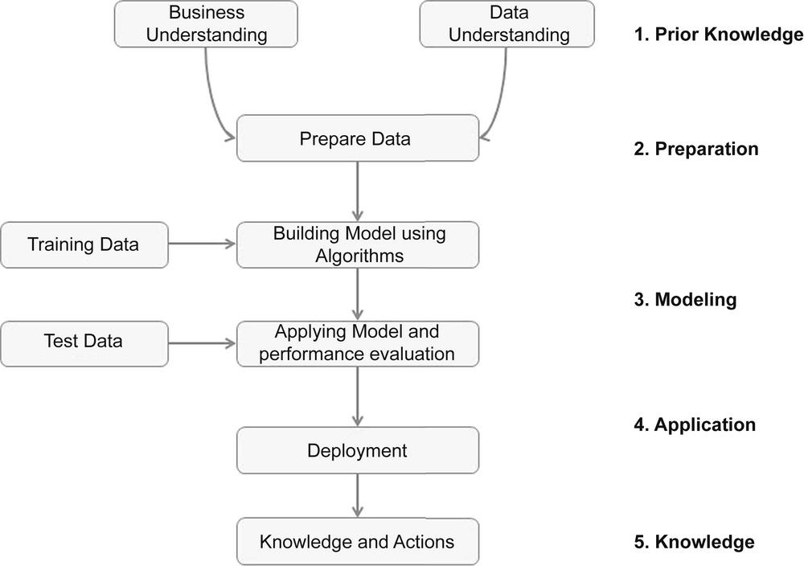
Generic Data mining process

Slide 34
Prior Knowledge
Data Mining tools/solutions identify hidden patterns.
Generally we get many patterns
Out of them many could be false or trivial.
Filtering false patterns requires domain understanding.
Understanding how the data is collected, stored, transformed, reported, and used is essential.
Causation vs. Correlation
A bank may decide interest rate based on credit score. Looking at data, credit score moves as per interest rate. It does not make sense to derive credit score from interest rate.

Slide 35
Data Preparation
Data needs to be understood. It requires descriptive statistics such as mean, median, mode, standard deviation, and range for each attribute
Data quality is an ongoing concern wherever data is collected, processed, and stored.
The data cleansing practices include elimination of duplicate records, quarantining outlier records that exceed the bounds, standardization of attribute values, substitution of missing values, etc.
it is critical to check the data using data exploration techniques in addition to using prior knowledge of the data and business before building models to ensure a certain degree of data quality
Missing Values
Need to track the data lineage of the data source to find right solution
Data Types and Conversion
The attributes in a data set can be of different types, such as continuous numeric (interest rate), integer numeric (credit score), or categorical
data mining algorithms impose different restrictions on what data types they accept as inputs
Transformation
Can go beyond type conversion, may include dimensionality reduction or numerosity reduction
Outliers are anomalies in the data set
May occur legitimately or erroneously.
Feature Selection
Many data mining problems involve a data set with hundreds to thousands of attributes, most of which may not be helpful. Some attributes may be correlated, e.g. sales amount and tax.
Data Sampling may be adequate in many cases

Slide 36
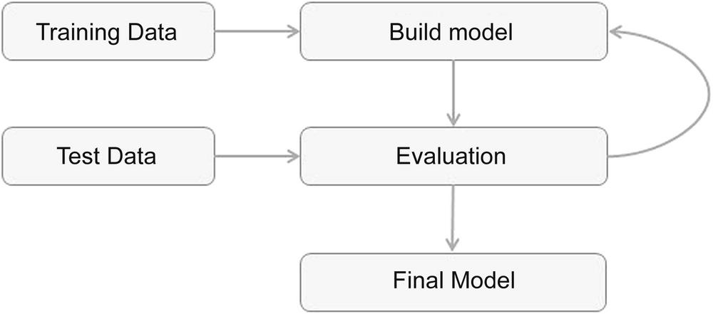
Modeling
A model is the abstract representation of the data and its relationships in a given data set.
Data mining models can be classified into the following categories: classification, regression, association analysis, clustering, and outlier or anomaly detection.
Each category has a few dozen different algorithms; each takes a slightly different approach to solve the problem at hand

Slide 37
Application
The model deployment stage considerations:
assessing model readiness, technical integration, response time, model maintenance, and assimilation
Production Readiness
Real-time response capabilities, and other business requirements
Technical Integration
Use of modeling tools (e.g. RapidMiner), Use of PMML for portable and consistent format of model description, integration with other tools
Timeliness
The trade-offs between production responsiveness and build time need to be considered
Remodeling
The conditions in which the model is built may change after deployment
Assimilation
The challenge is to assimilate the knowledge gained from data mining in the organization. For example, the objective may be finding logical clusters in the customer database so that separate treatment can be provided to each customer cluster.

Slide 38
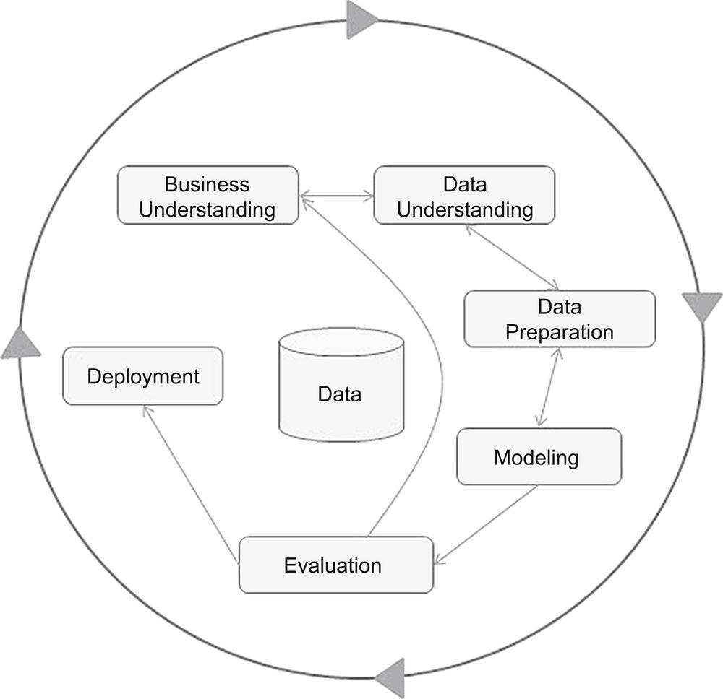
CRISP data mining framework
A popular data mining process frameworks is CRISP-DM (Cross Industry Standard Process for Data Mining). This framework was developed by a consortium of companies involved in data mining
CRISP is the most popular methodology for analytics, data mining, and data science projects, with 43% share as per 2014 KDnuggets Poll.
CRISP-DM was conceived in 1996. In 1997 it got underway as a European Union project, led by SPSS, Teradata, Daimler AG, NCR Corporation and OHRA.

Slide 39
DM Issues/Challenges – Mining Methodology
Mining Methodology involves the investigation of new kinds of knowledge, mining in multidimensional space, integrating methods from other disciplines, and the consideration of semantic ties among data objects.
Mining various and new kinds of knowledge: Data mining covers a wide spectrum of data analysis and knowledge discovery tasks, from data characterization and discrimination to association and correlation analysis, classification, regression, clustering, outlier analysis, sequence analysis, and trend and evolution analysis.
Mining knowledge in multidimensional space: When searching for knowledge in large data sets, we can explore the data in multidimensional space. That is, we can search for interesting patterns among combinations of dimensions (attributes) at varying levels of abstraction. Data can be aggregated or viewed as a multidimensional data cube.
Data mining—an interdisciplinary effort: For example, to mine data with natural language text, it makes sense to fuse data mining methods with methods of information retrieval and natural language processing, e.g. consider the mining of software bugs in large programs, known as bug mining, benefits from the incorporation of software engineering knowledge into the data mining process.
Boosting the power of discovery in a networked environment: Most data objects reside in a linked or interconnected environment, whether it be the Web, database relations, files, or documents. Semantic links across multiple data objects can be used to advantage in data mining.
Handling uncertainty, noise, or incompleteness of data: Data often contain noise, errors, exceptions, or uncertainty, or are incomplete. Errors and noise may confuse the data mining process, leading to the derivation of erroneous patterns. Data cleaning, data preprocessing, outlier detection and removal, and uncertainty reasoning are examples of techniques that need to be integrated with the data mining process.
Pattern evaluation and pattern- or constraint-guided mining: What makes a pattern interesting may vary from user to user. Therefore, techniques are needed to assess the interestingness of discovered patterns based on subjective measures. These estimate the value of patterns with respect to a given user class, based on user beliefs or expectations.

Slide 40
DM Issues/Challenges – User Interaction
The user plays an important role in the data mining process. Interesting areas include how to interact with a data mining system, how to incorporate a user's background knowledge in mining, and how to visualize and comprehend data mining results.
Interactive mining: The data mining process should be highly interactive. Thus, it is important to build flexible user interfaces and an exploratory mining environment, facilitating the user's interaction with the system. A user may like to first sample a set of data, explore general characteristics of the data, and estimate potential mining results. Interactive mining should allow users to dynamically change the focus of a search, to refine mining requests based on returned results, and to drill, dice, and pivot through the data and knowledge space interactively, dynamically exploring "cube space" while mining.
Incorporation of background knowledge: Background knowledge, constraints, rules, and other information regarding the domain under study should be incorporated into the knowledge discovery process. Such knowledge can be used for pattern evaluation as well as to guide the search toward interesting patterns.
Ad hoc data mining and data mining query languages: Query languages (e.g., SQL) have played an important role in flexible searching because they allow users to pose ad hoc queries. Similarly, high-level data mining query languages or other high-level flexible user interfaces will give users the freedom to define ad hoc data mining tasks. This should facilitate specification of the relevant sets of data for analysis, the domain knowledge, the kinds of knowledge to be mined, and the conditions and constraints to be enforced on the discovered patterns. Optimization of the processing of such flexible mining requests is another promising area of study.
Presentation and visualization of data mining results: How can a data mining system present data mining results, vividly and flexibly, so that the discovered knowledge can be easily understood and directly usable by humans? This is especially crucial if the data mining process is interactive. It requires the system to adopt expressive knowledge representations, user-friendly interfaces, and visualization techniques.

Slide 41
DM Issues/Challenges - Efficiency and Scalability
Efficiency and scalability are always considered when comparing data mining algorithms. As data amounts continue to multiply, these two factors are especially critical.
Efficiency and scalability of data mining algorithms: Data mining algorithms must be efficient and scalable in order to effectively extract information from huge amounts of data in many data repositories or in dynamic data streams. In other words, the running time of a data mining algorithm must be predictable, short, and acceptable by applications. Efficiency, scalability, performance, optimization, and the ability to execute in real time are key criteria that drive the development of many new data mining algorithms.
Parallel, distributed, and incremental mining algorithms: The humongous size of many data sets, the wide distribution of data, and the computational complexity of some data mining methods are factors that motivate the development of parallel and distributed data-intensive mining algorithms. Such algorithms first partition the data into "pieces." Each piece is processed, in parallel, by searching for patterns. The parallel processes may interact with one another. The patterns from each partition are eventually merged.
Cloud computing and cluster computing, which use computers in a distributed and collaborative way to tackle very large-scale computational tasks, are also active research themes in parallel data mining. In addition, the high cost of some data mining processes and the incremental nature of input promote incremental data mining, which incorporates new data updates without having to mine the entire data "from scratch." Such methods perform knowledge modification incrementally to amend and strengthen what was previously discovered.

Slide 42
DM Issues/Challenges - Diversity of Database Types
The wide diversity of database types brings about challenges to data mining.
Handling complex types of data: Diverse applications generate a wide spectrum of new data types, from structured data such as relational and data warehouse data to semi-structured and unstructured data; from stable data repositories to dynamic data streams; from simple data objects to temporal data, biological sequences, sensor data, spatial data, hypertext data, multimedia data, software program code, Web data, and social network data. It is unrealistic to expect one data mining system to mine all kinds of data, given the diversity of data types and the different goals of data mining. Domain- or application-dedicated data mining systems are being constructed for in-depth mining of specific kinds of data. The construction of effective and efficient data mining tools for diverse applications remains a challenging area.
Mining dynamic, networked, and global data repositories: Multiple sources of data are connected by the Internet and various kinds of networks, forming gigantic, distributed, and heterogeneous global information systems and networks. The discovery of knowledge from different sources of structured, semi-structured, or unstructured yet interconnected data with diverse data semantics poses great challenges to data mining. Mining such gigantic, interconnected information networks may help disclose many more patterns and knowledge in heterogeneous data sets than can be discovered from a small set of isolated data repositories. Web mining, multisource data mining, and information network mining have become challenging and fast-evolving data mining fields.

Slide 43
DM Issues/Challenges - Society
How does data mining impact society? What steps can data mining take to preserve the privacy of individuals? Do we use data mining in our daily lives without even knowing that we do?
Social impacts of data mining: With data mining penetrating our everyday lives, it is important to study the impact of data mining on society. How can we use data mining technology to benefit society? How can we guard against its misuse? The improper disclosure or use of data and the potential violation of individual privacy and data protection rights are areas of concern that need to be addressed.
Privacy-preserving data mining: Data mining will help scientific discovery, business management, economy recovery, and security protection (e.g., the real-time discovery of intruders and cyberattacks). However, it poses the risk of disclosing an individual's personal information. Studies on privacy-preserving data publishing and data mining are ongoing. The philosophy is to observe data sensitivity and preserve people's privacy while performing successful data mining.
Invisible data mining: We cannot expect everyone in society to learn and master data mining techniques. More and more systems should have data mining functions built within so that people can perform data mining or use data mining results simply by mouse clicking, without any knowledge of data mining algorithms. Intelligent search engines and Internet-based stores perform such invisible data mining by incorporating data mining into their components to improve their functionality and performance. This is done often unbeknownst to the user. For example, when purchasing items online, users may be unaware that the store is likely collecting data on the buying patterns of its customers, which may be used to recommend other items for purchase in the future.

